Slide 1
Wellness in Practice GAAAA Conference 2025
Candice D. McKinley, State Bar of GA Wellness Committee Vice Chair

Slide 2
The WHY?
GOALS
To assess the well-being of lawyers in relation to ethical trends in the practice;
To destigmatize the role of well-being in the practice;
Identify the habits/practices of a well lawyer;
To walk away from this session with concrete resources that support well-being in the practice to decrease the instances of ethical violations; and
To foster new insights on ways to support your personal well-being.
The Intersectionality of Well-Being and Ethical Considerations in the Law

Slide 3
Cousin Candice
Notes:
Mother, Creative, Traveler, and new member of the Nap Ministry

Slide 4
SUPER HERO MYTH
Notes:
Set the Room Opening
Ask to Stand: First Generation College, Law School
**Estate/Trust planning lawyers: Stand or remain standing (Audience—Remember who they are and seek out their services)

Slide 5
WHY NOW?
Mental Health Trends in the Practice of Law
Notes:
Preamble: A Lawyer's Responsibilities
"...[4] In all professional functions a lawyer should be competent, prompt and diligent. A lawyer should maintain communication with a client concerning the representation. A lawyer should keep in confidence information relating to representation of a client except so far as disclosure is required or permitted by the Rules of Professional Conduct or other law.
[7] Many of a lawyer's professional responsibilities are prescribed in the Rules of Professional Conduct, as well as substantive and procedural law. However, a lawyer is also guided by personal conscience and the approbation of professional peers. A lawyer should strive to attain the highest level of skill, to improve the law and the legal profession and to exemplify the legal profession's ideals of public service.
[12] The legal profession's relative autonomy carries with it special responsibilities of self-government. The profession has a responsibility to assure that its regulations are conceived in the public interest and not in furtherance of parochial or self-interested concerns of the bar. Every lawyer is responsible for observance of the Rules of Professional Conduct. A lawyer should also aid in securing their observance by other lawyers. Neglect of these responsibilities compromises the independence of the profession and the public interest which it serves.
SCOPE
[20] Violation of a Rule should not itself give rise to a cause of action against a lawyer nor should it create any presumption in such a case that a legal duty has been breached. In addition, violation of a Rule does not necessarily warrant any other non-disciplinary remedy, such as disqualification of a lawyer in pending litigation. The Rules are designed to provide guidance to lawyers and to provide a structure for regulating conduct through disciplinary agencies. They are not designed to be a basis for civil liability. Furthermore, the purpose of the Rules can be subverted when they are invoked by opposing parties as procedural weapons. The fact that a Rule is a just basis for a lawyer's self-assessment, or for sanctioning a lawyer under the administration of a disciplinary authority, does not imply that an antagonist in a collateral proceeding or transaction has standing to seek enforcement of the Rule. Nevertheless, since the Rules do establish standards of conduct by lawyers, a lawyer's violation of a Rule may be evidence of breach of the applicable standard of conduct.

Slide 6
Mental Health Trends Studies 2014-2020
THE REAL NUMBERS
2014 FINDINGS
2016 FINDINGS
2020 FINDINGS
After three years in law 40% of law school students are depressed
Attorneys who face formal discipline 25% are identified as suffering from addiction or mental illness
Substance abuse plays a role in 60% of malpractice claims and of all trust fund violation
Lawyers are amongst the TOP 10% professions for suicide
28% of the responding lawyers experienced depression
19% experienced anxiety and 23% experienced stress
21% of the lawyers reported problematic alcohol use
Approximately 50% of practicing attorneys are experiencing symptoms of depression and anxiety
30% of those falling in the mild range and nearly 20% falling in the moderate/severe range
Notes:
A 2014 article by the ABA notes that “at least 25 percent of attorneys who face formal disciplinary charges from their state bar are identified as suffering from addiction or other mental illness,” and that substance abuse plays a role in “60 percent of all disciplinary cases … 60 percent of all malpractice claims and 85 percent of all trust fund violation cases.”
The 2016 ABA study found that alcohol use disorders and mental health problems are happening in the legal profession at higher rates than in other professions and the general population. That study found that 28% of the responding lawyers experienced depression, 19% experienced anxiety and 23% experienced stress. The ABA study also found that 20.6% of the lawyers reported problematic alcohol use.
A 2020 study featuring participants such as the California Lawyers Association and the D.C. Bar found “Roughly half of practicing attorneys are experiencing symptoms of depression and anxiety, with approximately 30% of those falling in the mild range and nearly 20% falling in the moderate/severe range..”

Slide 7
LOSS/GRIEF/DEPRESSION
2018-Present
Notes:
2018 Story of Self
Cousin passing in 2019 at the early age
Grandma’s sudden passing Sept. 2023
Surgery, healthy scare, & car accident in 2024
Javoyne Story of her husband’s suicide

Slide 8
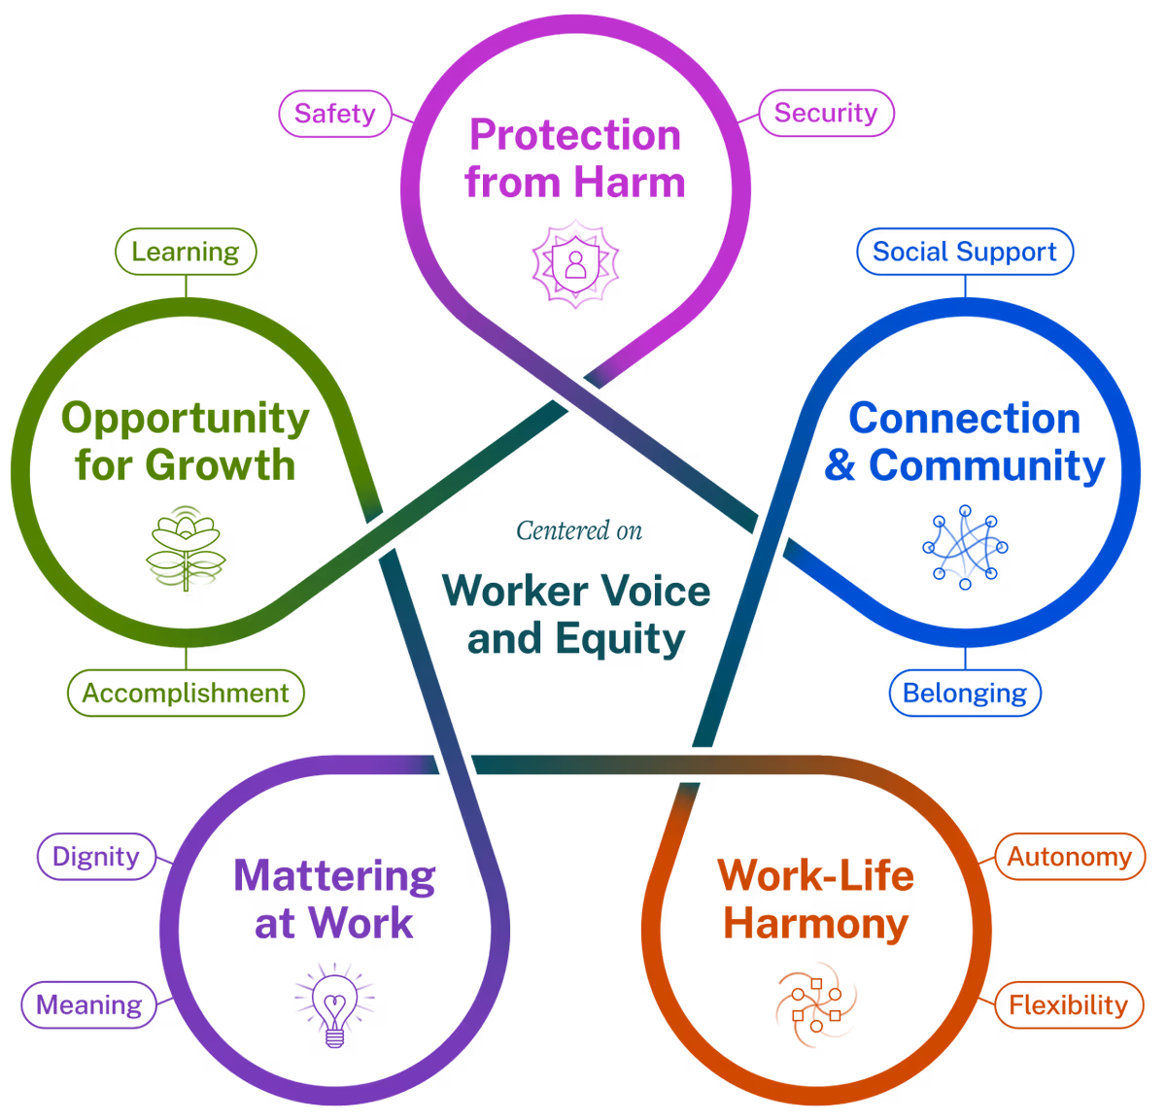
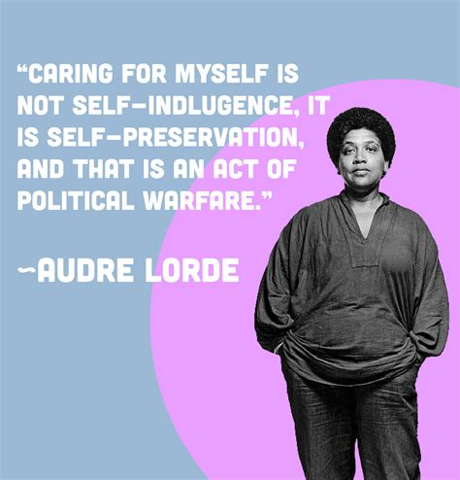
U.S. Surgeon General’s Five-Factor Framework for Workplace Mental Health and Well-Being
Notes:
Question to Audience: How do you show up in your work environment?
Resource: https://www.hhs.gov/surgeongeneral/priorities/workplace-well-being/index.html

Slide 9
The HOW?
Centering Mindfulness in the Ethical Considerations of the Practice of Law
Notes:
Mindfulness Practice: SEE/HEAR/SMELL/FEEL-TOUCH
"Mindfulness in Law Schools: The Path to Well-Being" by Charity Scott - Charity Scott's article explores the benefits of mindfulness in legal education and practice. It serves as an excellent introduction to the topic.
Self-Care Plan/Intentionality to prioritize well-being in your everyday life
What does a well lawyer look like?
ARTICLES:
"Mindfulness in Law Schools: The Path to Well-Being" by Charity Scott - Charity Scott's article explores the benefits of mindfulness in legal education and practice.
"Mindfulness in the Legal Profession: A Preliminary Study on the Effects of Mindfulness on Stress, Burnout, and Psychological Well-Being" by Rachel J. Shier - This study examines the impact of mindfulness on stress and well-being among law students and practitioners.

Slide 10
American Bar Association Model Rules
Know The Rules
Notes:
Review in large group the Rule categories that each group will have an opportunity to develop a skit (Model Here) to present.
What steps can you take when you are diagnosed with a potential terminal disease and your anxiety hits the roof?

Slide 11
Topic # 1
Are there any specific observations regarding mental health and or well-being practices that you have observed/witnessed in your area or other work environments, especially regarding African Americans post-pandemic?

Slide 12
Topic #2
Mental Health Awareness
What support if any do you believe organizations/associations should provide or plan to provide to assist more in well-being/mental health awareness?

Slide 13
WELL-BEING RESOURCES
Gratitude: The Gratitude app seeks to support those with anxiety and depression by targeting their perceptions of their lives. Features include a daily dose of inspiring quotes and affirmations, daily reminders, and function to write gratitude letters and attach photos. It’s essentially a gratitude journal that can be used anywhere.
This brief Burnout Self-Test from MindTools assesses the way you feel about your job and your experiences at work, so that you can get a feel for whether you are at risk of burnout. It also provides links to relevant articles about avoiding and recovering from burnout.
PositivePsychology.com offers a free Self-Care Check-In worksheet that provides a quick way to see where more attention is needed to ensure you’re meeting your self-care needs.
The Day One Journal is a digital journal for Apple users with numerous features to help develop good habits, including gratitude and mindfulness. You can store photos, videos, audio files, and other data and also add reminders for appointments.
Notes:
Ask audience to share any apps/habits/techniques they use for their well-being.

Slide 14
WELL-BEING RESOURCES
African American Specific Websites
Therapy for Black Girls: Support for Black women to find a virtual or in-person therapist.
Therapy for Black Men: Support for Black men to find a virtual or in-person therapist.
Nap Ministry: Believes that rest is a form of resistance and names sleep deprivation as a racial and social justice issue.
Exhale: An Emotional Well-Being App for BIWOC
Notes:
Ask audience to share any apps/habits/techniques they use for their well-being.

Slide 15
GET YOUR HOUSE IN ORDER
✅ Draft a Succession Plan in accordance with our Georgia Bar rules.
✅ Appoint a Successor Attorney and establish a Durable Power of Attorney.
✅ Create a Closing Checklist that includes client notification, file transfer, and financial account management.
Notes:
Succession Planning for Client Files & Ethical Responsibilities
An attorney must ensure that client files are managed ethically during a transition or closure, in compliance with ABA Model Rule 1.15 (Safekeeping Property) and Rule 1.16 (Declining or Terminating Representation).
Key Considerations:
Identify a Successor Attorney: Designate a trusted attorney to take over your cases in the event of incapacitation or death. This can be formalized through a succession agreement.
Client Notification Procedures: Include a client notification plan in your estate plan. Clients must be informed of the transition or closure and provided with instructions on how to retrieve their files or find new representation.
File Retention & Destruction Policy: Outline a file retention and destruction policy to ensure compliance with state bar rules. Decide how long files will be kept and how they will be securely destroyed if no longer needed.

Slide 16
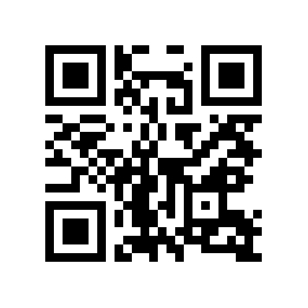
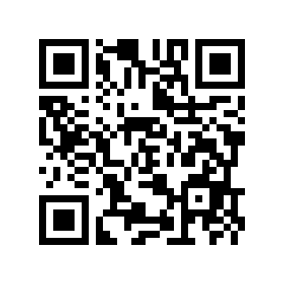
WELL-BEING RESOURCES
Georgia State Bar Wellness Committee
Institute for Well-Being
in the Law (“IWIL”)
Notes:
Institute for well-being in the Law
GA Bar Association: https://www.gabar.org/wellness/

Slide 17
Commit to Your Well-Being Baby Step
Candice D. McKinley
+1 678.713.4320
Cmckinley@cmlfirm.com
@IamCandiceLaw

